Slide 1

SAFETRADE A STOCK RECOMMENDER
SUPERVISOR & COORDINATOR BATCH MEMBERS
Dr. Anitha Julian, M.E., Ph.D.,
Professor V.R.DikshitReddy(212219040026)
Computer Science and Engineering E.GaneshReddy(212219040028)
D.Somasekhar (212219040024)

Slide 2
Abstract
Business and finance sector is today the leader of the world's economy, stock market trading is a major practice in the finance sector.
The project is implemented LSTM using Keras API of google’s Tensorflow to predict values of stock while training the algorithm on past data. We concentrated on predicting the trend observed in the value of a stock for the next 20 days from the day of prediction.
It is basically a technique where one tries to predict the future value of current stocks of a company to avoid the loss or perhaps gain profit.
This project will demonstrate a machine learning approach to predict the same using various quantities mentioned later in this report.
Python is the programming language used for better reach and understanding.

Slide 3
CONTENTS OF THE PROJECT
Abstract
Introduction
Proposed Methodology
Architecture Diagram
List of Modules
Module Explanation
Module Implementation
References

Slide 4
LITERATURE SURVEY
S.NO | TITLE OF THE PROJECT | AUTHOR NAME | JOURNAL | METHOD AND DESCRIPTION | DRAWBACKS | YEAR
1. | A novel stock price forecasting method using the dynamic neural network. | Yu,S.Wang and L.Zhang. | Robots Intelligent Systems (ICRIS). | Hybrid method uses the Bayesian regression method and the EEEMD to perform regression prediction. | Uncertainity and nonlinearity of the stock time series. | 2019
2. | Stock price prediction on daily stock data. | Blint.J.Neural Netw.Adv.Appl.,5. | The Google Scholar on stock price. | Stock Price Prediction Using Regression Analysis. | Historical values of dataset inefficient. | 2018

Slide 5

Introduction
Stock price prediction is a popular yet challenging task and deep learning provides the means to conduct the mining for the different patterns that trigger its dynamic movement. This project
Can predict the best stock to buy or sell
Provide an efficient solution for easy investment in the stockAnd the most important thing: the audience will not miss any point of your presentation
Business and finance sector is today the leader of the world's economy, stock market trading is a major practice in the finance sector. We propose a Machine Learning Algorithm which will be trained from different datasets of some companies available from the past to make near effective predictions.

Slide 6

PROBLEM DEFINITION
To classify the Machine Learning Algorithm which will be trained from different datasets of some companies available from the past to make near effective predictions. Stock market prediction is a technique to determine the upcoming worth of a corporation’s stock or other financial instrument traded on an exchange.

Slide 7

PROPOSED SYSTEM
Deals with classification of brain tumour accurately from the source, big data based on Hadoop framework with SVM classifier.
The proposed methodology consists of the following modules:
Elimination of Secondary attributes
Clustering and Classification

Slide 8
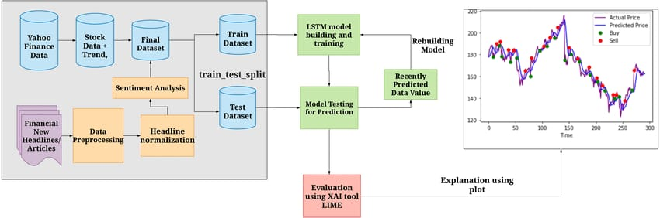
ARCHITECTURE DIAGRAM

Slide 9

LIST OF MODULES
Django
Machine Learning
Keras API
Web Interface Design

Slide 10
Dataset
Google
AMD
Tesla

Slide 11
Artificial Neural Network
Artificial Neural Networks are computational models and inspire by the human brain. Many of the recent advancements have been made in the field of Artificial Intelligence, including Voice Recognition, Image Recognition, Robotics using Artificial Neural Networks. Artificial Neural Networks are the biologically inspired simulations performed on the computer to perform certain specific tasks like –
Clustering
Classification
Pattern Recognition
Support Vector Machine
Support Vector Machine or SVM is one of the most popular Supervised Learning algorithms, which is used for Classification as well as Regression problems. However, primarily, it is used for Classification problems in Machine Learn
SVM can be of two types:
Linear SVM
Non-linear SVM
0

Slide 12
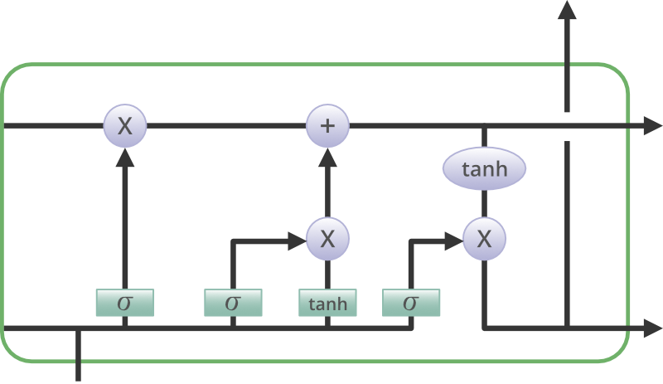
It is special kind of recurrent neural network that is capable of learning long term.Long Short Term Memory is a kind of recurrent neural network. In RNN output from the last step is fed as input in the current step. LSTM was designed by Hochreiter & Schmidhuber. It tackled the problem of long-term dependencies of RNN in which the RNN cannot predict the word stored in the long-term memory but can give more accurate predictions from the recent information. As the gap length increases RNN does not give an efficient performance. LSTM can by default retain the information for a long period of time. It is used for processing, predicting, and classifying on the basis data.
LONG SHORT TERM MEMORY

Slide 13
Django
Django is a widely used free, open-source, and high-level web development framework. It provides a lot of features to the developers "out of the box," .
So development can be rapid. However, websites built from it are secured, scalable, and maintainable at the same time.

Slide 14
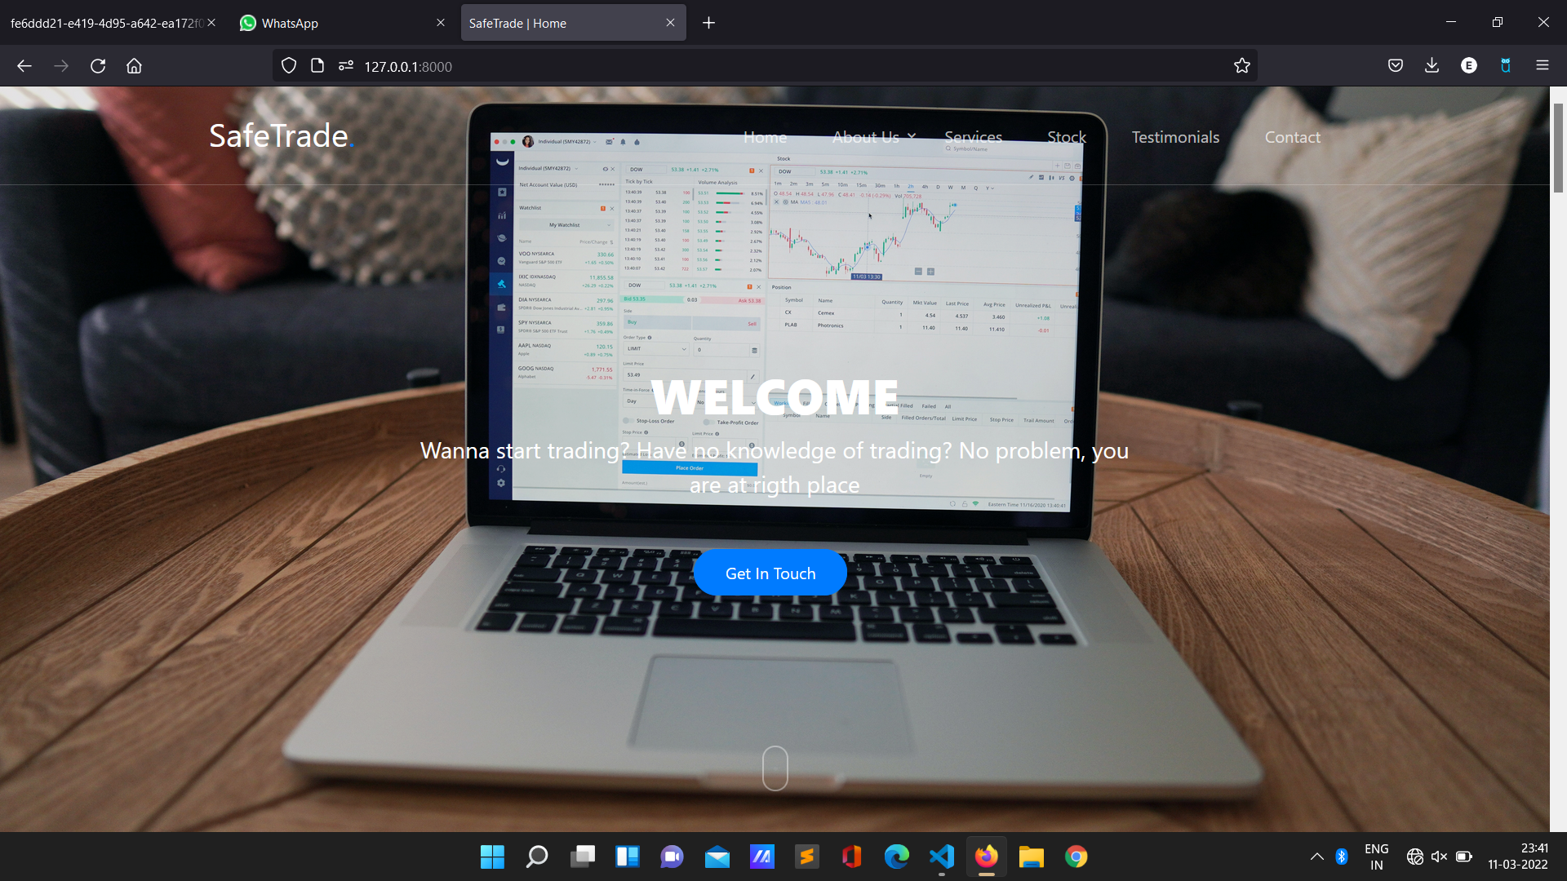
Module Implementation

Slide 15
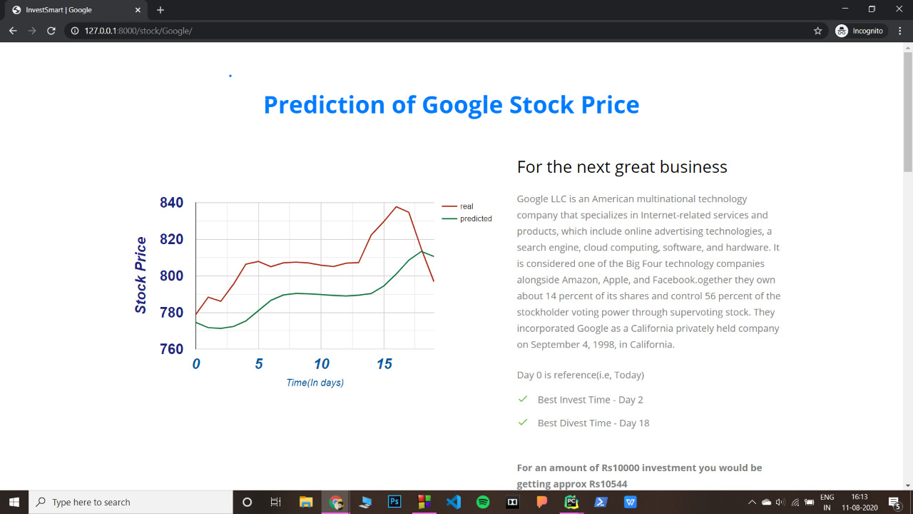
Module Implementation
Screen shot and output of module

Slide 16
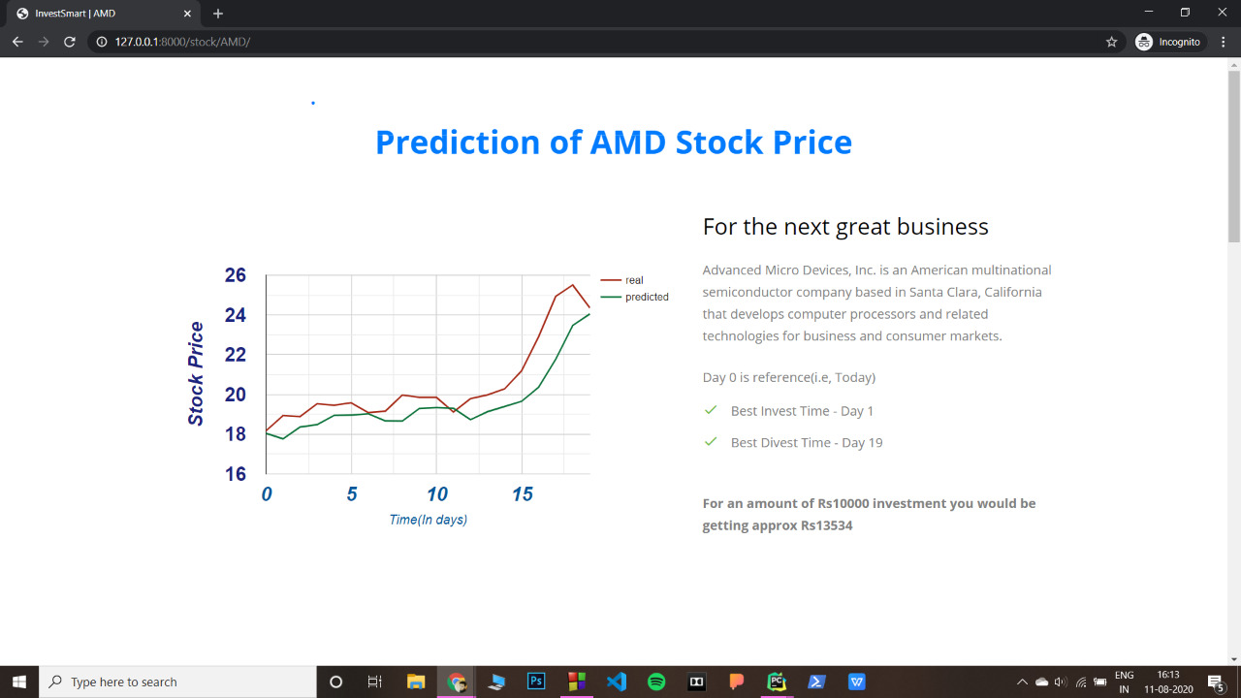
Module Implementation
Screen shot and output of module

Slide 17
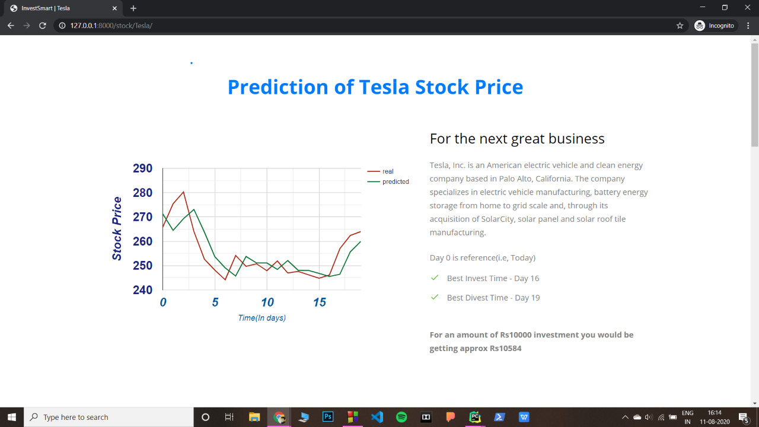
Module Implementation
Screen shot and output of module

Slide 18
Keras API
Keras is a deep learning API written in Python, running on top of the machine learning platform TensorFlow. It was developed with a focus on enabling fast experimentation. Being able to go from idea to result as fast as possible is key to doing good research.
Keras is an open-source-softwarelibrary that provides a Python interface for artificial neural networks. Keras acts as an interface for the TensorFlow library.

Slide 19
REFERENCES
1. S.Liu and G.Liao and Y.Ding ,“Stock transaction prediction modelling and analysis based on LSTM”,2018 13th IEEE Conference on Industrial Electronics and Application(ICIEA), pp. 2787-2790, 2018.
T.Gao and Y.Chai and Y.Liu, “Applying long short term memory neural networks for predicting stock closing price”, 2017 8th IEEE International Conference on Software Engineering and Service Science (ICSESS), pp. 575 - 578, 2017.
M.Usmani, S.H.Adil, ,K.Raza and S.S.A.Ali, “Stock market prediction using machine learning techniques”, 2016 3rd International Conference on Computer and Information Sciences(ICCOINS), pp.322-327,2016.
H.Gunduz and Z.Cataltepe and Y.Yaslan, “Stock market direction prediction using deep neural networks:, 2017 25th Signal Processing and Communications Applications Conference (SIU), pp. 1-4, 2017.

Slide 20
THANK YOU

